Slide 1
Discussion about this week’s reading
What about the readings?

Slide 2
What a journey!
We started by counting words and got all the way to giving numerical representations to words.
Think about each week as a tool you now have in your toolkit.
Not all tools are useful for every task. As you work more and more with them, you will see which tool helps you more with what.

Slide 3
My process
Here is a rough outline of my process with text data:
What is the research question? My hypotheses? How can I operationalize my variables?
What information from my data do I need to answer it? If I was to read every document in my corpus, would I be able to identify the concept myself? Can I do it consistently?
What does my data look like?
How clean is my data?
If these are tweets, what does a tweet look like? What is its structure? If these are speeches, what does a speech look like? What is its structure?
What is the distribution of length of my documents? What are common tokens?
Is there information in my documents that I can use as metadata?
What is the simplest, most efficient tool, to extract the concept that I need from my data?
Am I actually capturing what I claim to be capturing?
Validate, validate, validate

Slide 4
Your projects
We are half-way through the class. By now, you should have some idea of what your final submission looks like.
Who wants to share first?

Slide 5
Getting Data
Prof. Sebastián Vallejo Vera

Slide 6
Text-as-data has widened the scope of the social sciences (see Grimmer et al. 2022).
Ok, but how do I get that data? How do I load it into my computer? Is it legal to do so?
Let’s take a look…

Slide 7
Getting Data

Slide 8
1. So you have some pdfs…
Ok… so you have some PDFs. Now what?
In this week’s code I will show you how you can OCR these documents, load them into R, and organize them in way that you can start pre-processing them.
I will also provide some tips on organization and naming conventions.

Slide 9
2. I do not have PDFs, but I know where to find them
Ok, so you do not currently have the PDFs, but you know a website where you can download them. There just does not seem to be a way to get them in bulk.
In this week’s code I will show you how you can, from R, bulk download these documents.

Slide 10
3. There is data on webpages that I want to use
So maybe there is some text on webpages that might be helpful in your research.
In this week’s code I will show you how you can scrape that text as well.

Slide 11
4. Where else can I look?
Well, if you go to the main page of the course’s site (https://svallejovera.github.io/cpa_uwo/), there is a list of readily available datasets.
Look for packages that can help you:

Slide 12
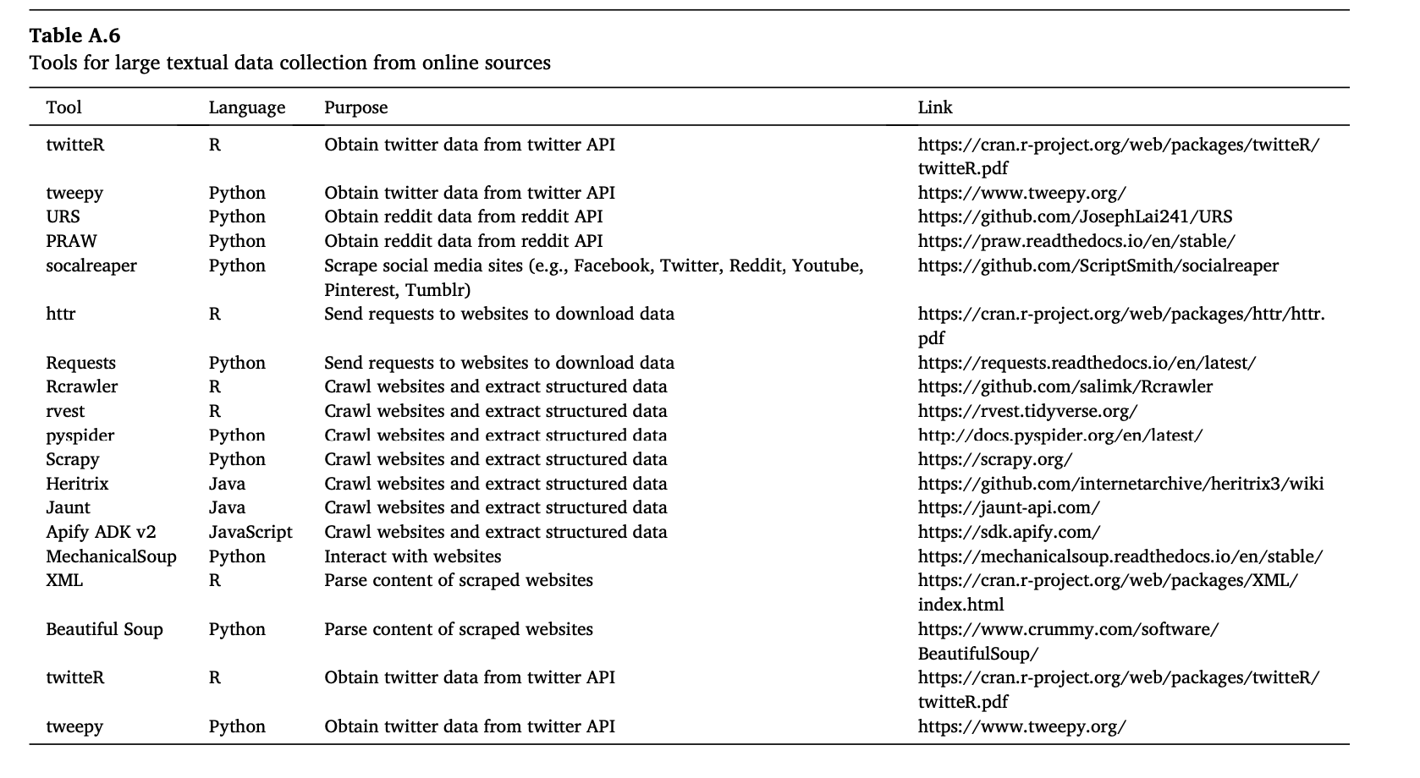

Slide 13
From Barrie’s Website:
YouTube API
https://youtube-data-api.readthedocs.io/en/latest/
Spotify API
https://www.rcharlie.com/spotifyr/
Genius API
https://cran.r-project.org/web/packages/geniusr/vignettes/geniusr.html
Guardian Newspaper API
https://cran.r-project.org/web/packages/guardianapi/vignettes/introduction.html
Or search “API” in https://cran.r-project.org/web/packages/available_packages_by_name.html
Or search API directory in Programmable Web: https://www.programmableweb.com/apis/directory
Or work through this collaborative online review of APIs, written in R: https://bookdown.org/paul/apis_for_social_scientists/

Slide 14
Think about your Research Design

Slide 15
Unit of analysis:
Who or what are we studying?
Over what time frame?
Sampling:
Where is the data coming from?
Is my sample an accurate representation of the broader population I want to make inferences about?
Inference:
For example: Can I compare the behavior of people online with the behavior of people off line?

Slide 16
Think about the legal aspect

Slide 17
Is content copyrighted?
Does scraping infringe IP rights?
Are there “terms of use” or “terms of service” for the platform?
Do your due diligence…

Slide 18
Best practices
Contact webpage owners in advance of scraping to prewarn
Optimize scraper to minimize demand
Avoid crashing a site
Run scraper at night or when webpage receives least traffic
Other people might be trying to access the webpage as well

Slide 19
Think about the ethical aspect
Ethics > Legal

Slide 20
Resources
Freelon, D. (2018). Computational research in the post-API age. Political Communication, 35(4), 665-668.
Bruns, A. (2019). After the ‘APIcalypse’: Social media platforms and their fight against critical scholarly research. Information, Communication & Society, 22(11), 1544-1566.
Puschmann, C. (2019). An end to the wild west of social media research: A response to Axel Bruns. Information, Communication & Society, 22(11), 1582-1589.
Salganik, M. J. (2019). Bit by bit: Social research in the digital age. Princeton University Press.

